Slide 1
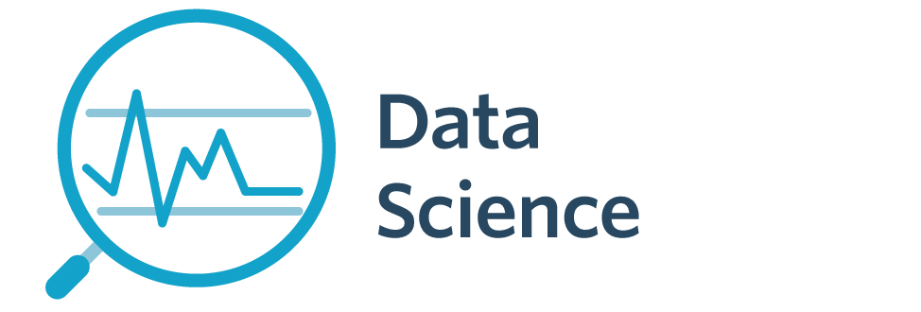

5005CEM Lecture 7a: What is Big Data?
School of Computing, Mathematics and Data Science Coventry University
5005CEM Data Science 2022/23 Semester 2

Slide 2
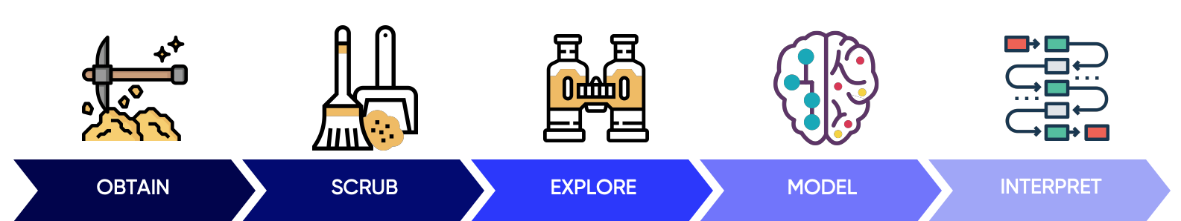
Recap
Data Science project lifecycle/pipeline/workflow
Exploratory data analysis (EDA) — summarise/visualise data (“story telling”), correlation, scatter matrix
So far, we have assumed we can load an entire dataset into the memory of a single computer

Slide 3
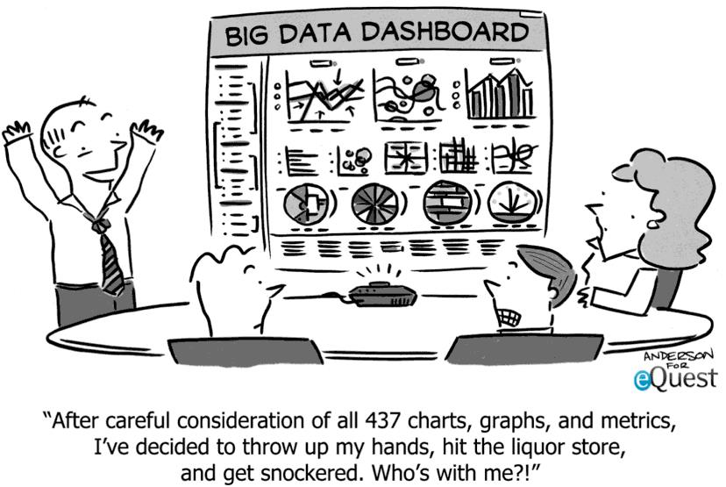
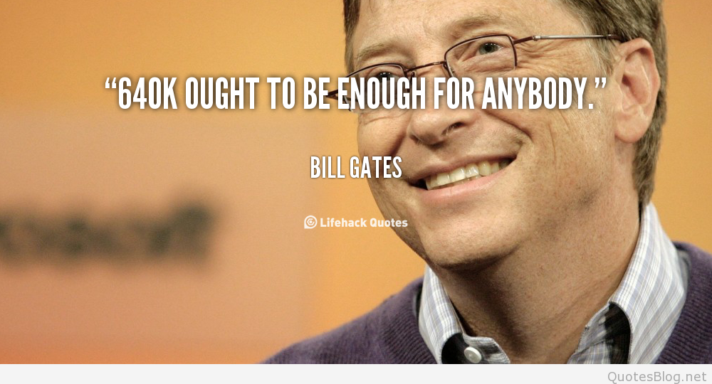
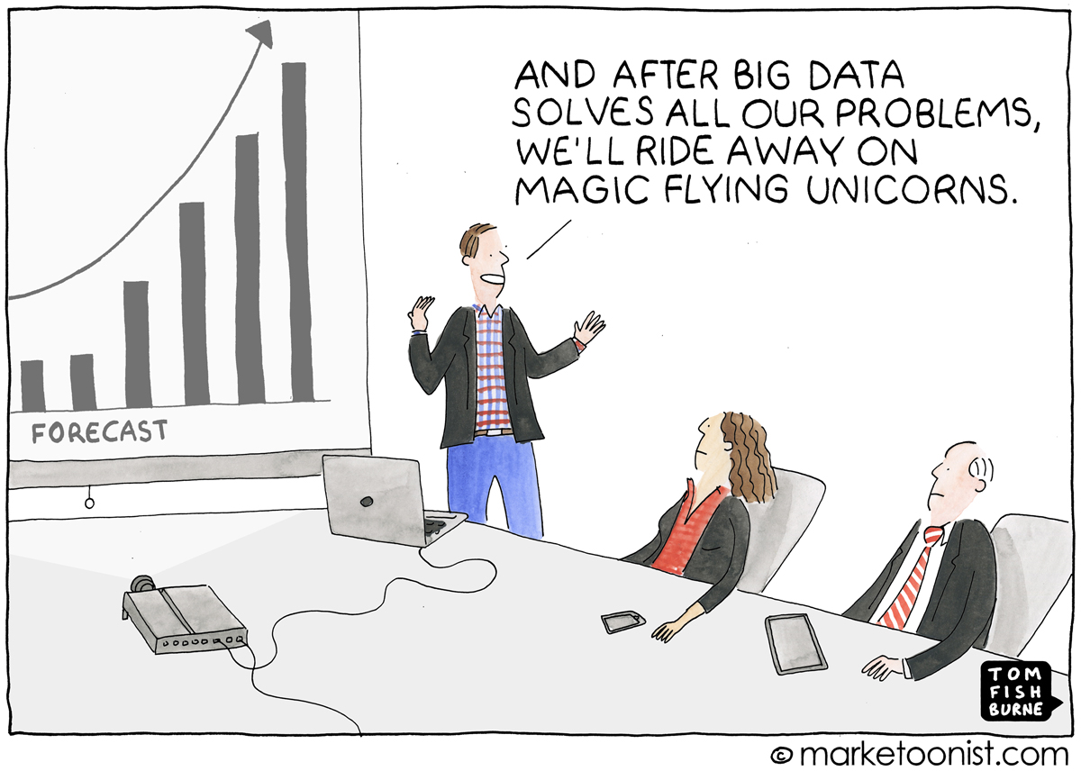
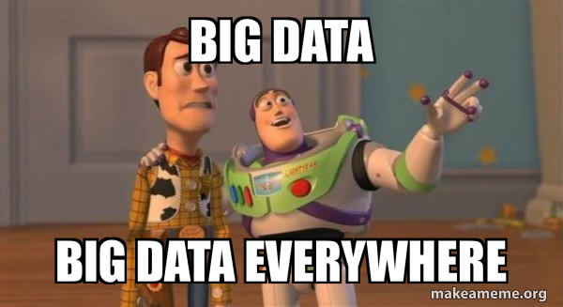
“Big” Data
Notes:
Image from: https://marketoonist.com/2017/03/bigdata.html
Image from: https://datafloq.com/read/10-really-cool-data-cartoons-you-have-to-see/867
Image from: https://quotesblog.net/top-bill-gates-quotes-images/quote-bill-gates-640k-ought-to-be-enough-for-anybody-89027/
Image from: https://makeameme.org/meme/big-data-big-ce2802fe07

Slide 4

GAFA (the “Big Four”)
Google, Apple, Facebook, Amazon (+Microsoft)
What do they know about individuals?
Emails, search history, Youtube history, photos, likes
Location (timeline), click-log, advertisement profile, apps used
Emails, photos, videos, audio, contacts
Access to your webcam/ microphone (Alexa, etc), transcripts
People “pay” with data (whenever you use the service)
Data used/sold to target advertising
Notes:
Reading: https://www.theguardian.com/commentisfree/2018/mar/28/all-the-data-facebook-google-has-on-you-privacy

Slide 5
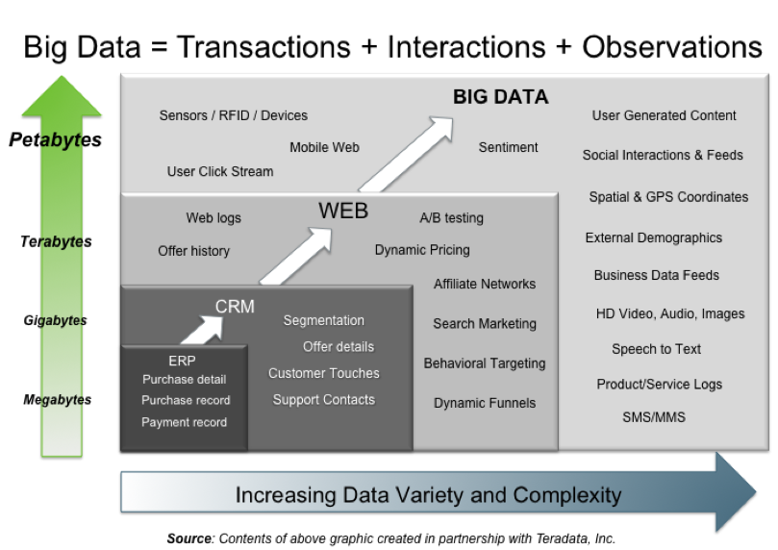
Sources of Big Data
Notes:
Image from: http://hortonworks.com/blog/7-key-drivers-for-the-big-data-market/
Data from activities, conversations, photos/videos, sensors, IoT

Slide 6
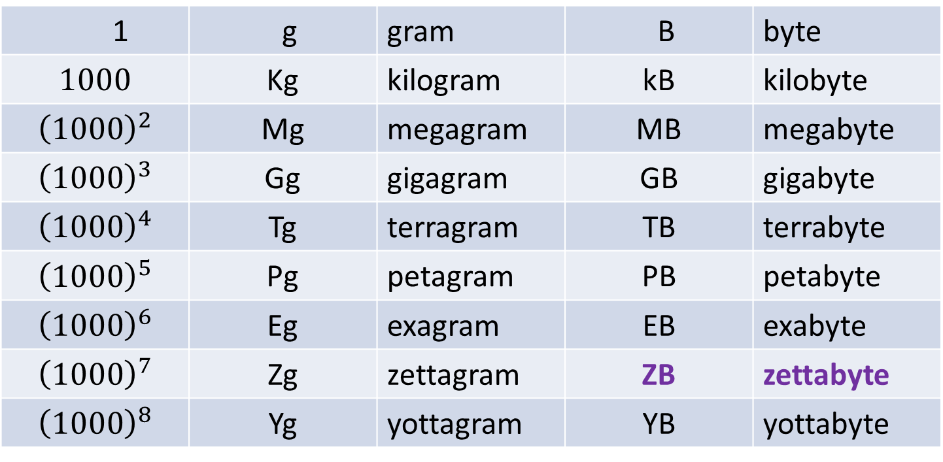
We live in the “zettabyte era”
1 | g | gram | B | byte
$$1000$$ | Kg | kilogram | kB | kilobyte
$${\left(1000\right)}^{2}$$ | Mg | megagram | MB | megabyte
$${\left(1000\right)}^{3}$$ | Gg | gigagram | GB | gigabyte
$${\left(1000\right)}^{4}$$ | Tg | terragram | TB | terrabyte
$${\left(1000\right)}^{5}$$ | Pg | petagram | PB | petabyte
$${\left(1000\right)}^{6}$$ | Eg | exagram | EB | exabyte
$${\left(1000\right)}^{7}$$ | Zg | zettagram | ZB | zettabyte
$${\left(1000\right)}^{8}$$ | Yg | yottagram | YB | yottabyte
Notes:
Reading: https://en.wikipedia.org/wiki/Zettabyte_Era

Slide 7
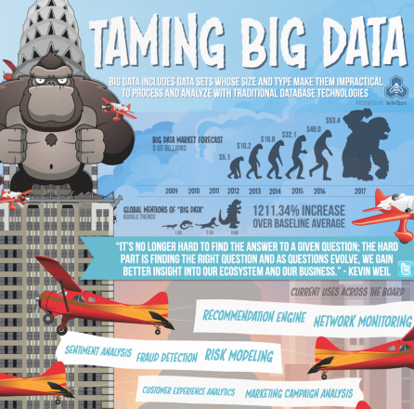
Notes:
Image from: https://wikibon.com/taming-big-data-a-big-data-infographic/

Slide 8
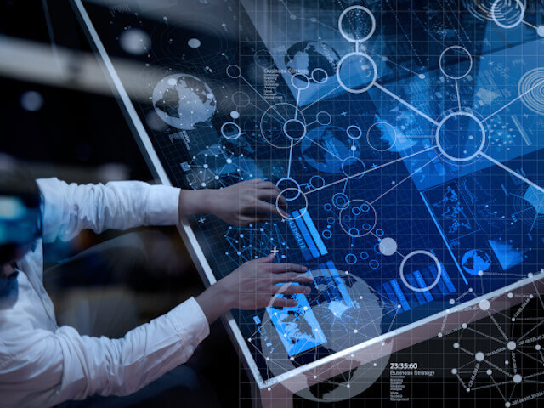
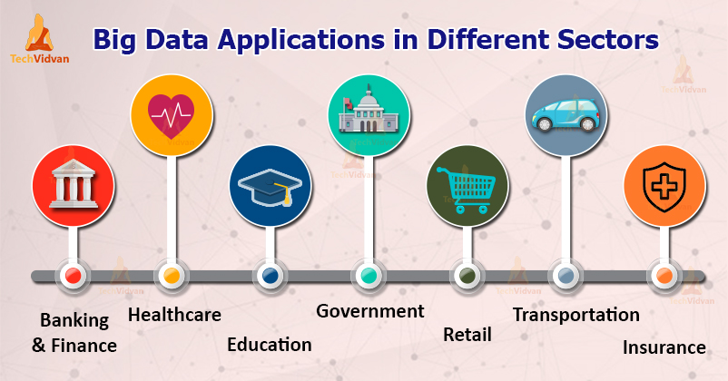
Big Data Applications
Music, TV shows, and movies
Healthcare and medical services
Shopping and marketing
Travel and transportation
Government, public policy and safety
News and information
Education and employment
Artificial intelligence
Banking, finance, and insurance
Energy and utilities
Notes:
Source: https://onlinedegrees.mtu.edu/news/ways-big-data-affects-your-personal-life
Source: https://techvidvan.com/tutorials/big-data-applications/

Slide 9
The Four Vs of Big Data
Volume (scale of data)
Small data (fits into main memory), e.g., CSV file
Medium data (fits on machine but not into memory), e.g., database
Big data (does not fit on a single machine), e.g., distributed file system, cloud/datacentre
Velocity (analysis of streaming data)
Variety (unstructured data)
Veracity (uncertainty of meaning data)

Slide 10
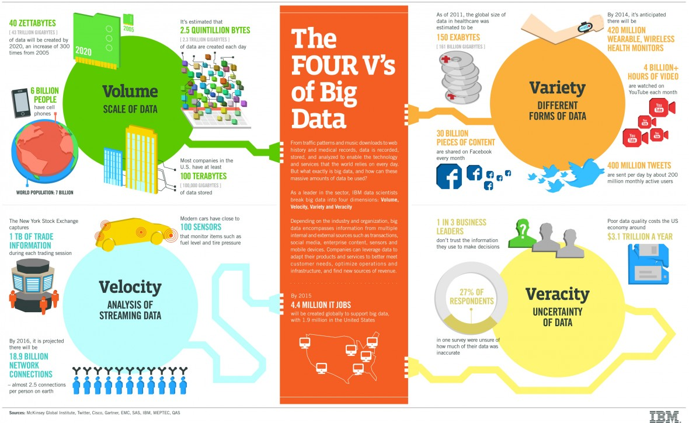
Hello
Notes:
Image from: https://www.ibmbigdatahub.com/infographic/four-vs-big-data

Slide 11
How many Vs?
Doug Laney (2001) 3D Data Management: Controlling Data Volume, Velocity, and Variety. META Group. volume, velocity, variety
Van Rijmenam (2014) describes (controversial) additions: veracity, validity, value, variability, venue, vocabulary, vagueness
These are mostly consequences of volume, velocity, variety
Notes:
Reading: https://www.datasciencecentral.com/profiles/blogs/top-10-list-the-v-s-of-big-data
Reading: https://datafloq.com/read/3vs-sufficient-describe-big-data/166

Slide 12
Big Data vs Multivariate Data
Multivariate Data
many columns/variables but few rows/observations (structured)
multivariate regression (vector response and vector predictor)
principal components analysis (PCA)
clustering and classification
Big Data
many rows/observations but few columns/variables (often just unstructured key/value pairs)
model overfitting (but more likely want to fit an individual model to each person)

Slide 13
Summary
GAFA (Google, Apple, Facebook, Amazon)
What do they know about individuals?
Big Data: volume or velocity or variety (+veracity, …)
Multivariate data
structured, many columns
vs Big Data
many rows, unstructured key/value pairs
images, video, audio, documents, streaming

Slide 14
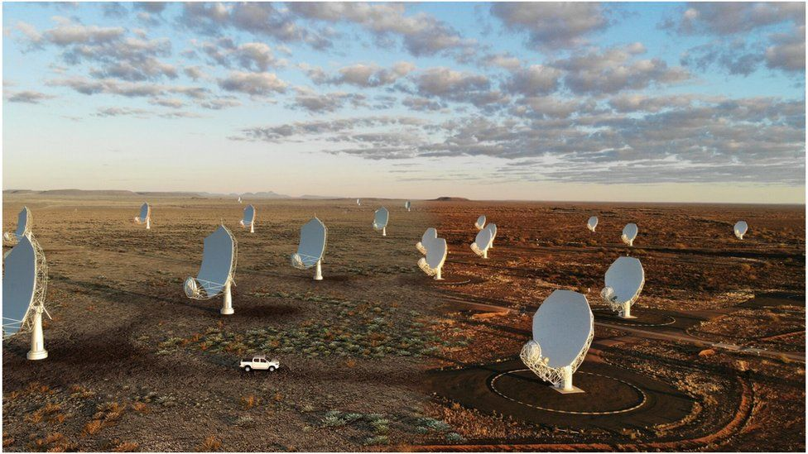
Class Discussion Question
Square Kilometre Array (SKA) of radio telescopes
Notes:
Image from: https://www.bbc.co.uk/news/science-environment-55933958

Slide 15
Class Discussion Question
The Square Kilometre Array (SKA) of thousands of radio telescopes is planned to be built in Australia and South Africa.
It is estimated that SKA will produce around 0.5 Exabytes of data every year, with each individual radio telescope estimated to produce approximately 1TB of raw data per second.
Justify why we might or might not consider this radio telescope data as Big Data.

Slide 16
Class Discussion Questions
(1) Are the 3Vs sufficient to characterise data as Big Data?
(2) Discuss the following quote:
“Every company has big data in its future and every company will eventually be in the data business.” — Thomas Davenport
(3) Are there any dangers of Big Data?
Notes:
Recommended reading: https://theconversation.com/six-ways-and-counting-that-big-data-systems-are-harming-society-88660

